Slide 1
Representing Graphs and
Graph Isomorphism
(Chapter 10.3)
Connectivity
(Chapter 10.4)

Slide 2
Representing Graphs
a
a
d
b
b
d
c
c
Vertex
Adjacent Vertices
Initial Vertex
Terminal Vertices
a
b, c, d
a
c
b
a, d
b
a
c
a, d
c
d
a, b, c
d
a, b, c

Slide 3
Representing Graphs
Definition: Let G = (V, E) be a simple graph with |V| = n. Suppose that the vertices of G are listed in arbitrary order as v₁, v₂, …, v_{n}.
The adjacency matrix A (or A_{G}) of G, with respect to this listing of the vertices, is the n×n zero-one matrix with 1 as its (i, j) entry when v_{i} and v_{j} are adjacent, and 0 otherwise.
In other words, for an adjacency matrix A = [a_{ij}],
a_{ij} = 1 if {v_{i}, v_{j}} is an edge of G, a_{ij} = 0 otherwise.

Slide 4
Representing Graphs
Example: What is the adjacency matrix A_{G} for the following graph G based on the order of vertices a, b, c, d ?
a
b
d
c
Solution:
Note: Adjacency matrices of undirected graphs are always symmetric.

Slide 5
Representing Directed Graphs
Example: What is the adjacency matrix A_{G} for the following directed graph G based on the order of vertices a, b, c, d ?
a
d
b
c
Solution:

Slide 6
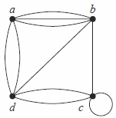
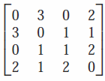
Representing Pseudographs
Example: What is the adjacency matrix A_{G} for the following preudograph G based on the order of vertices a, b, c, d ?
Solution:

Slide 7
Representing Graphs
Definition: Let G = (V, E) be an undirected graph with |V| = n. Suppose that the vertices and edges of G are listed in arbitrary order as v₁, v₂, …, v_{n} and e₁, e₂, …, e_{m}, respectively.
The incidence matrix of G with respect to this listing of the vertices and edges is the n×m zero-one matrix with 1 as its (i, j) entry when edge e_{j} is incident with v_{i}, and 0 otherwise.
In other words, for an incidence matrix M = [m_{ij}],
m_{ij} = 1 if edge e_{j} is incident with v_{i} m_{ij} = 0 otherwise.

Slide 8
Representing Graphs
Example: What is the incidence matrix M for the following graph G based on the order of vertices a, b, c, d and edges 1, 2, 3, 4, 5, 6?
a
1
2
b
d
3
5
4
c
6
Solution:
Note: Incidence matrices of undirected graphs contain two 1s per column for edges connecting two vertices and one 1 per column for loops.

Slide 9
Isomorphism of Graphs
Definition: The simple graphs G₁ = (V₁, E₁) and G₂ = (V₂, E₂) are isomorphic if there is a bijection (an one-to-one and onto function) f from V₁ to V₂ with the property that a and b are adjacent in G₁ if and only if f(a) and f(b) are adjacent in G₂, for all a and b in V₁.
Such a function f is called an isomorphism.
In other words, G₁ and G₂ are isomorphic if their vertices can be ordered in such a way that the adjacency matrices M_{G1} and M_{G2} are identical.

Slide 10
Isomorphism of Graphs
From a visual standpoint, G₁ and G₂ are isomorphic if they can be arranged in such a way that their displays are identical (of course without changing adjacency).
Unfortunately, for two simple graphs, each with n vertices, there are n! possible isomorphisms that we have to check in order to show that these graphs are isomorphic.
However, showing that two graphs are not isomorphic can be easy.

Slide 11
Isomorphism of Graphs
For this purpose we can check invariants, that is, properties that two isomorphic simple graphs must both have.
For example, they must have
the same number of vertices,
the same number of edges, and
the same degrees of vertices.
Note that two graphs that differ in any of these invariants are not isomorphic, but two graphs that match in all of them are not necessarily isomorphic.

Slide 12
Isomorphism of Graphs
Example I: Are the following two graphs isomorphic?
a
a
b
e
e
b
c
d
c
d
Solution: Yes, they are isomorphic, because they can be arranged to look identical. You can see this if in the right graph you move vertex b to the left of the edge {a, c}. Then the isomorphism f from the left to the right graph is: f(a) = e, f(b) = a, f(c) = b, f(d) = c, f(e) = d.

Slide 13
Isomorphism of Graphs
Example II: How about these two graphs?
a
a
b
e
e
b
c
c
d
d
Solution: No, they are not isomorphic, because they differ in the degrees of their vertices.
Vertex d in right graph is of degree one, but there is no such vertex in the left graph.

Slide 14
Example
Are these two graphs isomorphic?
u₁ u₂
u₅ u₃
u₄
v₁ v₂
v₅
v₃
v₄
G H
They both have 5 vertices
They both have 8 edges
They have the same number of vertices with the same degrees: 2, 3, 3, 4, 4.

Slide 15
Example (Cont.)
G H H → G?
u₁ u₂ u₃ u₄ u₅
u₁ 0 1 0 1 1
u₂ 1 0 1 1 1
u₃ 0 1 0 1 0
u₄ 1 1 1 0 1
u₅ 1 1 0 1 0
v₁ v₂ v₃ v₄ v₅
v₁ 0 0 1 1 1
v₂ 0 0 1 0 1
v₃ 1 1 0 1 1
v₄ 1 0 1 0 1
v₅ 1 1 1 1 0
v₁ v₃ v₂ v₅ v₄
v₁
v₃
v₂
v₅
v₄
G and H don’t appear to be isomorphic.
However, we haven’t tried mapping vertices from G onto H yet.

Slide 16
Example (Cont.)
Start with the vertices of degree 2 since each graph only has one:
deg(u₃) = deg(v₂) = 2 therefore f(u₃) = v₂

Slide 17
Example (Cont.)
Now consider vertices of degree 3
deg(u₁) = deg(u₅) = deg(v₁) = deg(v₄) = 3
therefore we must have either one of
f(u₁) = v₁ and f(u₅) = v₄
f(u₁) = v₄ and f(u₅) = v₁

Slide 18
Example (Cont.)
Now try vertices of degree 4:
deg(u₂) = deg(u₄) = deg(v₃) = deg(v₅) = 4
therefore we must have one of:
f(u₂) = v₃ and f(u₄) = v₅ or
f(u₂) = v₅ and f(u₄) = v₃

Slide 19
Example (Cont.)
There are four possibilities (this can get messy!)
f(u₁) = v₁, f(u₂) = v₃, f(u₃) = v₂, f(u₄) = v₅, f(u₅) = v₄
f(u₁) = v₄, f(u₂) = v₃, f(u₃) = v₂, f(u₄) = v₅, f(u₅) = v₁
f(u₁) = v₁, f(u₂) = v₅, f(u₃) = v₂, f(u₄) = v₃, f(u₅) = v₄
f(u₁) = v₄, f(u₂) = v₅, f(u₃) = v₂, f(u₄) = v₃, f(u₅) = v₁

Slide 20
Example (Cont.)
G H H’
u₁ u₂ u₃ u₄ u₅
u₁ 0 1 0 1 1
u₂ 1 0 1 1 1
u₃ 0 1 0 1 0
u₄ 1 1 1 0 1
u₅ 1 1 0 1 0
v₁ v₂ v₃ v₄ v₅
v₁ 0 0 1 1 1
v₂ 0 0 1 0 1
v₃ 1 1 0 1 1
v₄ 1 0 1 0 1
v₅ 1 1 1 1 0
v₁ v₃ v₂ v₅ v₄
v₁ 0 1 0 1 1
v₃ 1 0 1 1 1
v₂ 0 1 0 1 0
v₅ 1 1 1 0 1
v₄ 1 1 0 1 0
We permute the adjacency matrix of H (per function choices above) to see if we get the adjacency of G. Let’s try:
f(u₁) = v₁, f(u₂) = v₃, f(u₃) = v₂, f(u₄) = v₅, f(u₅) = v₄
Does G = H’? Yes!

Slide 21
Example (Cont.)
G H H’
u₁ u₂ u₃ u₄ u₅
u₁ 0 1 0 1 1
u₂ 1 0 1 1 1
u₃ 0 1 0 1 0
u₄ 1 1 1 0 1
u₅ 1 1 0 1 0
v₁ v₂ v₃ v₄ v₅
v₁ 0 0 1 1 1
v₂ 0 0 1 0 1
v₃ 1 1 0 1 1
v₄ 1 0 1 0 1
v₅ 1 1 1 1 0
v₄ v₃ v₂ v₅ v₁
v₄ 0 1 0 1 1
v₃ 1 0 1 1 1
v₂ 0 1 0 1 0
v₅ 1 1 1 0 1
v₁ 1 1 0 1 0
It turns out that
f(u₁) = v₄, f(u₂) = v₃, f(u₃) = v₂, f(u₄) = v₅, f(u₅) = v₁
also works.

Slide 22
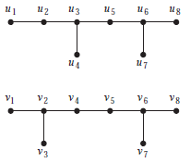
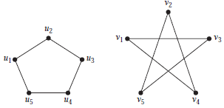
Examples
Determine if the following two graphs G₁ and G₂ are isomorphic:
Question 35, p. 676
Question 41, p. 677

Slide 23
Connectivity
Definition: A path of length n from u to v, where n is a positive integer, in an undirected graph is a sequence of edges e₁, e₂, …, e_{n} of the graph such that e₁ = {x₀, x₁}, e₂ = {x₁, x₂}, …, e_{n} = {x_{n-1}, x_{n}}, where x₀ = u and x_{n} = v.
When the graph is simple, we denote this path by its vertex sequence x₀, x₁, …, x_{n}, since it uniquely determines the path.
The path is a circuit if it begins and ends at the same vertex, that is, if u = v.

Slide 24
Connectivity
Definition (continued): The path or circuit is said to pass through or traverse x₁, x₂, …, x_{n-1}.
A path or circuit is simple if it does not contain the same edge more than once.

Slide 25
Connectivity
Let us now look at something new:
Definition: An undirected graph is called connected if there is a path between every pair of distinct vertices in the graph.
For example, any two computers in a network can communicate if and only if the graph of this network is connected.
Note: A graph consisting of only one vertex is always connected, because it does not contain any pair of distinct vertices.

Slide 26
Connectivity
Example: Are the following graphs connected?
a
b
a
b
e
e
d
d
c
c
Yes.
No.
a
b
a
b
e
e
d
c
d
f
c
Yes.
No.

Slide 27
Connectivity
Definition: A graph that is not connected is the union of two or more connected subgraphs, each pair of which has no vertex in common. These disjoint connected subgraphs are called the connected components of the graph.
Definition: A connected component of a graph G is a maximal connected subgraph of G.
E.g., if vertex v in G belongs to a connected component, then all other vertices in G that is connected to v must also belong to that component.

Slide 28
Connectivity
Example: What are the connected components in the following graph?
i
h
d
a
e
g
b
c
f
j
Solution: The connected components are the graphs with vertices {a, b, c, d}, {e}, {f}, {i, g, h, j}.

Slide 29
Connectivity
Definition: An directed graph is strongly connected if there is a path from a to b and from b to a whenever a and b are vertices in the graph.
Definition: An directed graph is weakly connected if there is a path between any two vertices in the underlying undirected graph.

Slide 30
Connectivity
Example: Are the following directed graphs strongly or weakly connected?
a
Weakly connected, because, for example, there is no path from b to d.
b
d
c
a
Strongly connected, because there are paths between all possible pairs of vertices.
b
d
c

Slide 31
The Connected Components of the Web Graph
Recall that at any particular instant the web graph provides a snapshot of the web, where vertices represent web pages and edges represent links. According to a 1999 study, the Web graph at that time had over 200 million vertices and over 1.5 billion edges. (The numbers today are several orders of magnitude larger.)
The underlying undirected graph of this Web graph has a connected component that includes approximately 90% of the vertices.
There is a giant strongly connected component (GSCC) consisting of more than 53 million vertices. A Web page in this component can be reached by following links starting in any other page of the component. There are three other categories of pages with each having about 44 million vertices:
pages that can be reached from a page in the GSCC, but do not link back.
pages that link back to the GSCC, but can not be reached by following links from pages in the GSCC.
pages that cannot reach pages in the GSCC and can not be reached from pages in the GSCC.

Slide 32
How connected is a graph? Cut vertices and edges
If one can remove a vertex (and all incident edges) and produce a graph with more components, the vertex is called a cut vertex or articulation point.
Similarly if removal of an edge creates more components the edge is called a cut edge or bridge.

Slide 33
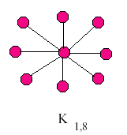
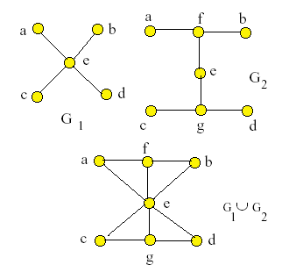
In the star network the
center vertex is a cut vertex.
All edges are cut edges.
In the graphs G₁ and G₂ every edge is a cut edge.
In the union, no edge is a cut edge.
Vertex e is a cut vertex in all graphs.

Slide 34
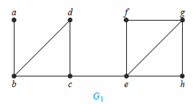
EXAMPLE: Find the cut vertices and cut edges in the graph G₁.
Solution: The cut vertices of G₁ are b, c, and e. The removal of one of these vertices (and its
adjacent edges) disconnects the graph.
The cut edges are {a, b} and {c, e}. Removing either one of these edges disconnects G₁.

Slide 35
Not all graphs have cut vertices. For example, the complete graph K_{n}, where n ≥ 3, has no cut vertices. When you remove a vertex from K_{n} and all edges incident to it, the resulting subgraph is the complete graph K_{n−1}, a connected graph.
K₅
K₄

Slide 36
Connected graphs without cut vertices are called nonseparable graphs, and can be thought of as more connected than those with a cut vertex.
We can extend this notion by defining a more granulated measure of graph connectivity based on the minimum number of vertices that can be removed to disconnect a graph.

Slide 37
A subset S of the vertex set V of G = (V ,E) is a vertex cut, or separating set, if V − S is disconnected. We define the vertex connectivity
of a noncomplete graph G, denoted by κ(G), as the minimum number of vertices in a separating set.
When G is a complete graph, we set κ(K_{n}) = n − 1.
Hence, for every graph G, κ(G) is minimum number of vertices that can be removed from G to either disconnect G or produce a graph with a single vertex.
We have 0 ≤ κ(G) ≤ n − 1 if G has n vertices,
κ(G) = 0 if and only if G is disconnected or G = K₁, and κ(G) = n − 1 if and only if G is complete .

Slide 38
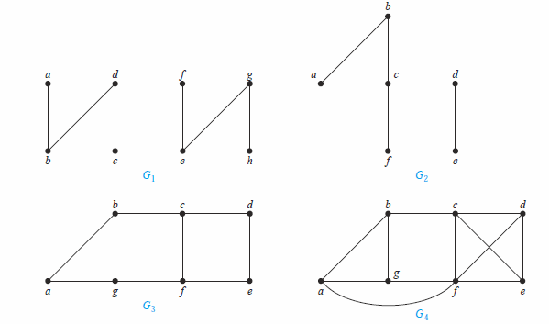
EXAMPLE: Find the vertex connectivity for each of the graphs:
Solution: Because G1 is a connected graph with a cut vertex, κ(G1) = 1. Similarly, κ(G2) = 1, because c is a cut vertex of G2.
G3 has no cut vertices. but {b, g} is a separating set. Hence, κ(G3) = 2. Similarly, G4 has a separating set of size two, {c, f }, but no cut vertices. It follows that κ(G4) = 2.

Slide 39
The larger κ(G) is, the more connected we consider G to be. Disconnected graphs and K₁
have κ(G) = 0, connected graphs with cut vertices and K₂ have κ(G) = 1, graphs without cut
vertices that can be disconnected by removing two vertices and K₃ have κ(G) = 2, and so
on. We say that a graph is k-connected (or k-vertex-connected), if κ(G) ≥ k. A graph G is 1-connected if it is connected and not a graph containing a single vertex; a graph is 2-connected, or biconnected, if it is nonseparable and has at least three vertices. Note that if G is a k-connected graph, then G is a j -connected graph for all j with 0 ≤ j ≤ k.

Slide 40
Counting Paths between Vertices
Isomorphic graphs must have ‘the same’ paths. If one is a simple circuit of length k,
then so must be the other.
We can use the adjacency matrix of a graph to find the number of paths between two vertices in the graph.
Theorem: Let G be a graph with adjacency matrix A with respect to the ordering v₁, … , v_{n} of vertices (with directed or undirected edges, multiple edges and loops allowed). The number of different paths of length r from v_{i} to v_{j}, where r >0 is a positive integer, equals the (i,j)th entry of A^{r}.
Note: This is the standard power of matrix A,
not a Boolean product.
Proof is given below. First an example.

Slide 41
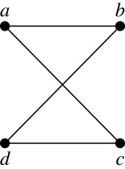
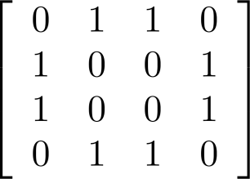
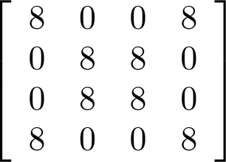
Example: How many paths of length four are there from a to d in the graph G.
Solution: The adjacency matrix of G is given above. Hence the number of paths of length four from a to d is the (1, 4)th entry of A⁴ . The eight paths are as:
adjacency matrix A of G
G
A⁴ =
a, b, a, b, d a, b, a, c, d
a, b, d, b, d a, b, d, c, d
a, c, a, b, d a, c, a, c, d
a, c, d, b, d a, c, d, c, d

Slide 42
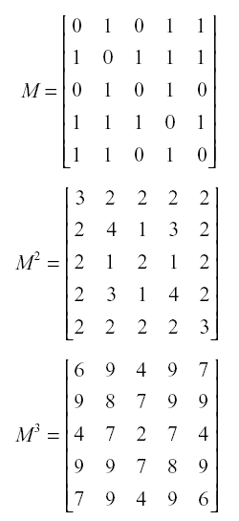
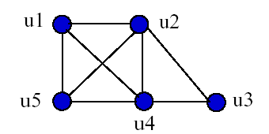
Example 2

Slide 43
Theorem: Let G be a graph with adjacency matrix A with respect to the orderingv₁, … , v_{n} of vertices. The number of different paths of length r from v_{i} to v_{j}, where r >0 is a positive integer, equals the (i,j)th entry of A^{r}.
Proof by mathematical induction:
Basis Step: By definition of the adjacency matrix, the number of paths from v_{i} to v_{j} of length 1 is the (i,j)th entry of A.
Inductive Step: For the inductive hypothesis, we assume that that the (i,j)th entry of A^{r} is the number of different paths of length r from v_{i} to v_{j}.
Because A^{r+1} = A^{r} A, the (i,j)th entry of A^{r+1} equals b_{i1}a_{1j} + b_{i2}a_{2j} + ⋯ + b_{in}a_{nj}, where b_{ik} is the (i,k)th entry of A^{r}. By the inductive hypothesis, b_{ik} is the number of paths of length r from v_{i} to v_{k}.
A path of length r + 1 from v_{i} to v_{j} is made up of a path of length r from v_{i} to some v_{k} , and an edge from v_{k} to v_{j}. By the product rule for counting, the number of such paths is the product of the number of paths of length r from v_{i} to v_{k} (i.e., b_{ik} ) and the number of edges from from v_{k} to v_{j} (i.e, a_{kj}). The sum over all possible intermediate vertices v_{k} is b_{i1}a_{1j} + b_{i2}a_{2j} + ⋯ + b_{in}a_{nj} .

